Slide 1
Object Detection

Slide 2
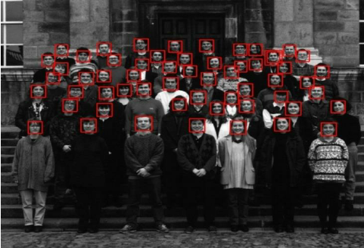
Object Detection Examples
Face Detection
* P. Viola and M. Jones. (2001): Robust real-time object detection.

Slide 3
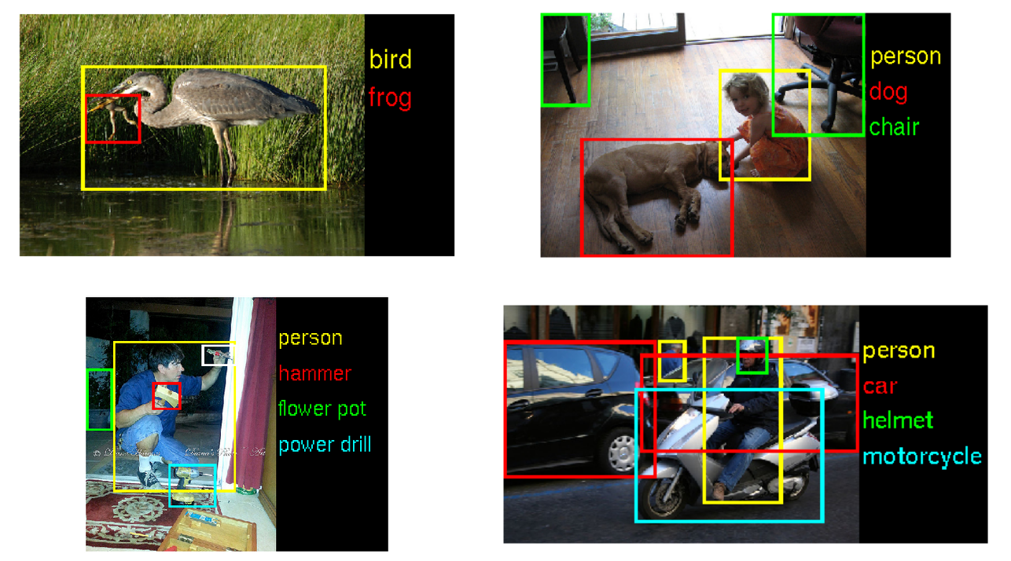
Object Detection Examples
More examples from the ImageNet Large Scale Visual Recognition Competition - ILSVRC

Slide 4



Object Detection at Amazon
Amazon Rekognition Image: a deep learning powered image recognition service
Object and Scene Detection
Face Analysis
Face Recognition
Face Comparison
Celebrity Recognition
Text in Image

Slide 5
Object Detection at Amazon
AmazonGo: purchase products without being checked out

Slide 6
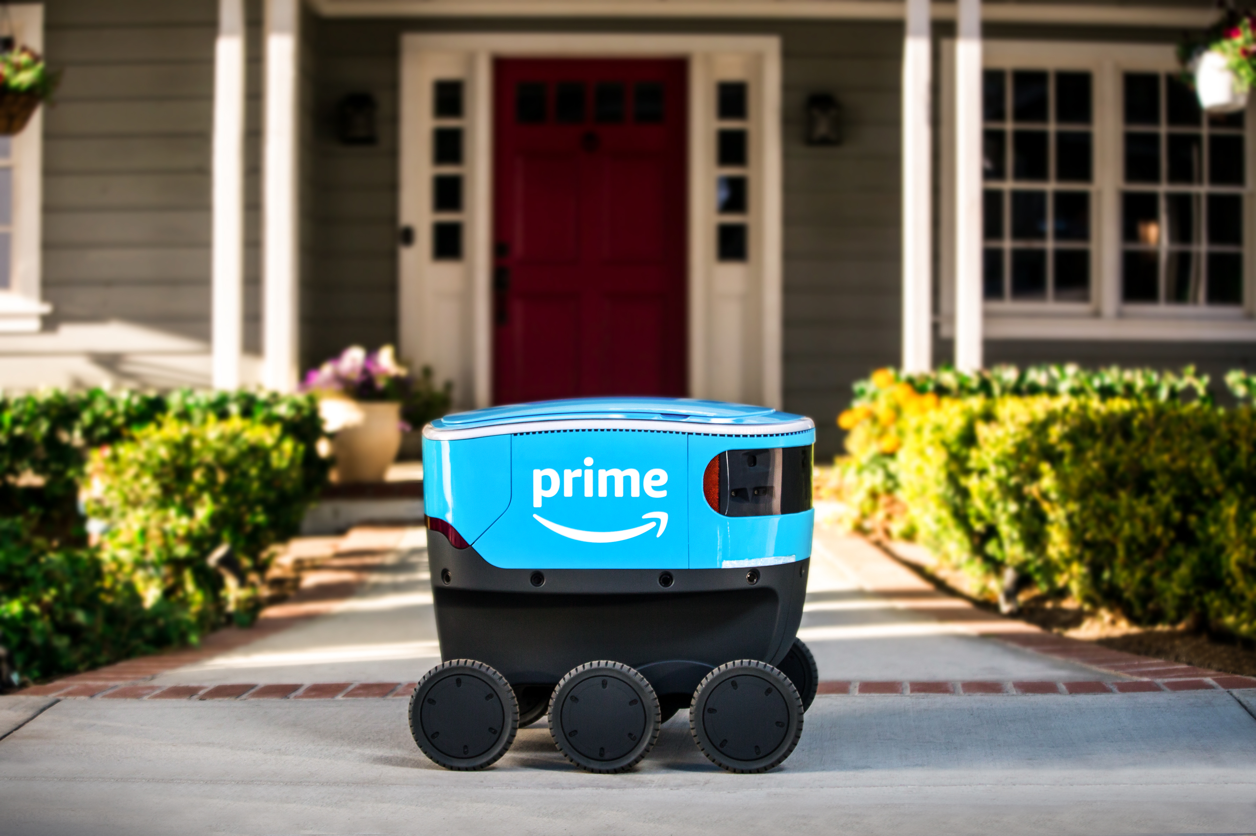
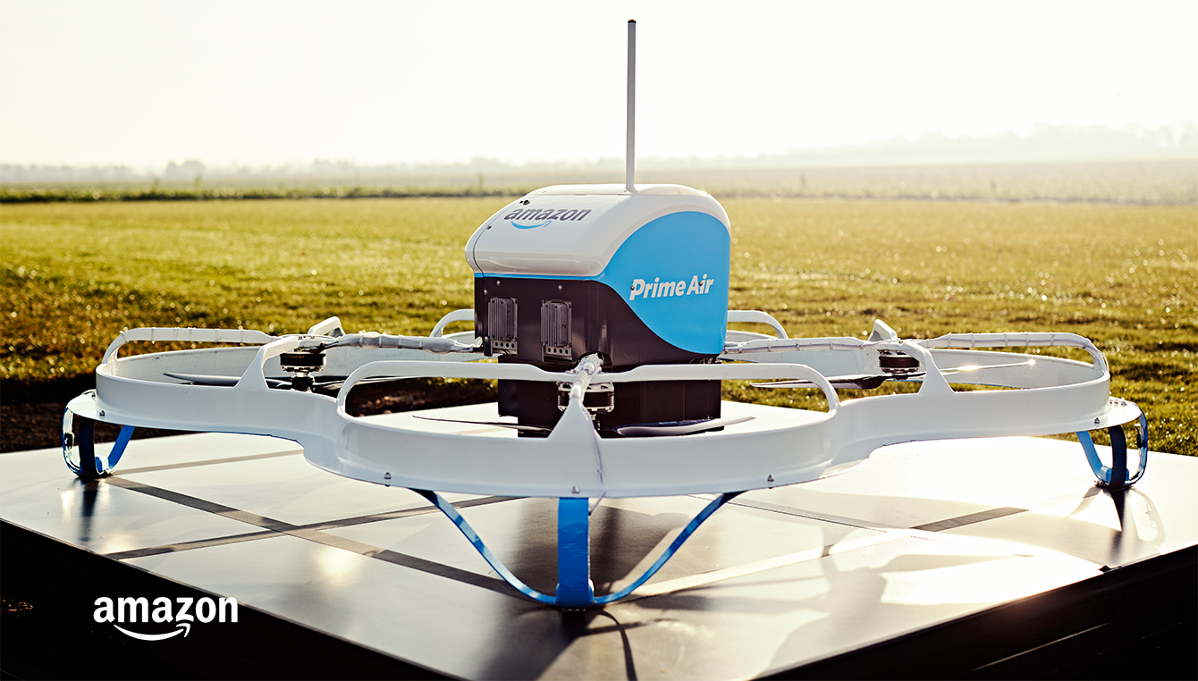
Object Detection at Amazon
Amazon Scout: Autonomous Amazon ground delivery service.
Amazon Prime Air: Autonomous Amazon air delivery service.
https://www.youtube.com/watch?v=peaKnkNX4vc
https://www.youtube.com/watch?v=vNySOrI2Ny8

